Slide 1


Azure SQL for Beginners Performance Troubleshooting Waiting due to deadlocks
Special Edition
#azuresql
aka.ms/azuresql4beginners

Slide 2


Performance is “slow” = Running vs Waiting
Low or
no CPU
High CPU
What queries are the top resource consuming queries or are waiting?

Slide 3



Running vs Waiting Scenarios
High CPU
Waiting
Missing Index
Blocking
Anti-pattern queries
Deadlocks
Lack of resources
Memory Grants

Slide 4



What is a deadlock?
Key Lock
SalesLT.ProductDescription
Requests Update (U) Lock
Owns Update (U) Lock
Session A
Session B
Rollback
Msg 1205
Key Lock
SalesLT.Product
Owns Exclusive (X) Lock
Requests Shared (S) Lock

Slide 5

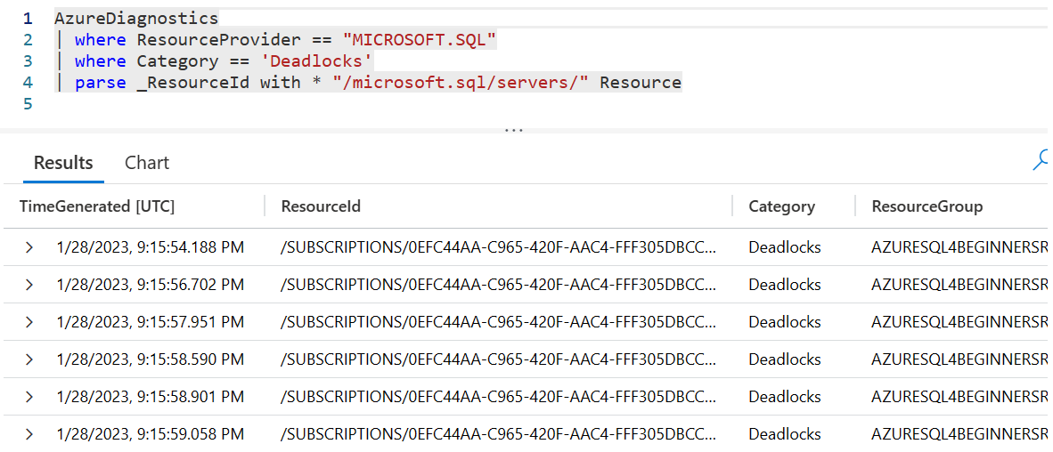
Using Azure Diagnostics and Kusto (KQL)
Errors
Deadlocks
Wait Statistics
…
Kusto
Query
Language (KQL)

Slide 6
The troubleshooting process
Identify low or no CPU
Check to see if blocking using DMVs
If not persisted blocking, look to see if deadlocks are occurring
Apply best practices to avoid deadlocks
Look at Top Resource Consuming Queries
Try it yourself at https://aka.ms/azuresqlworkshop

Slide 7
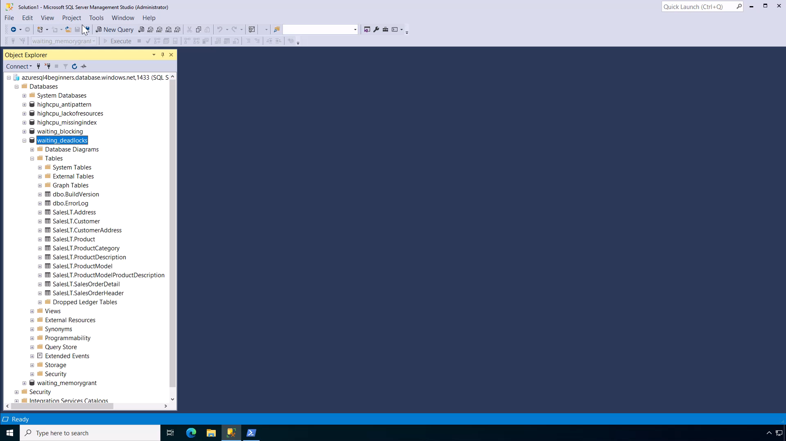
Notes:
15 secs

Slide 8
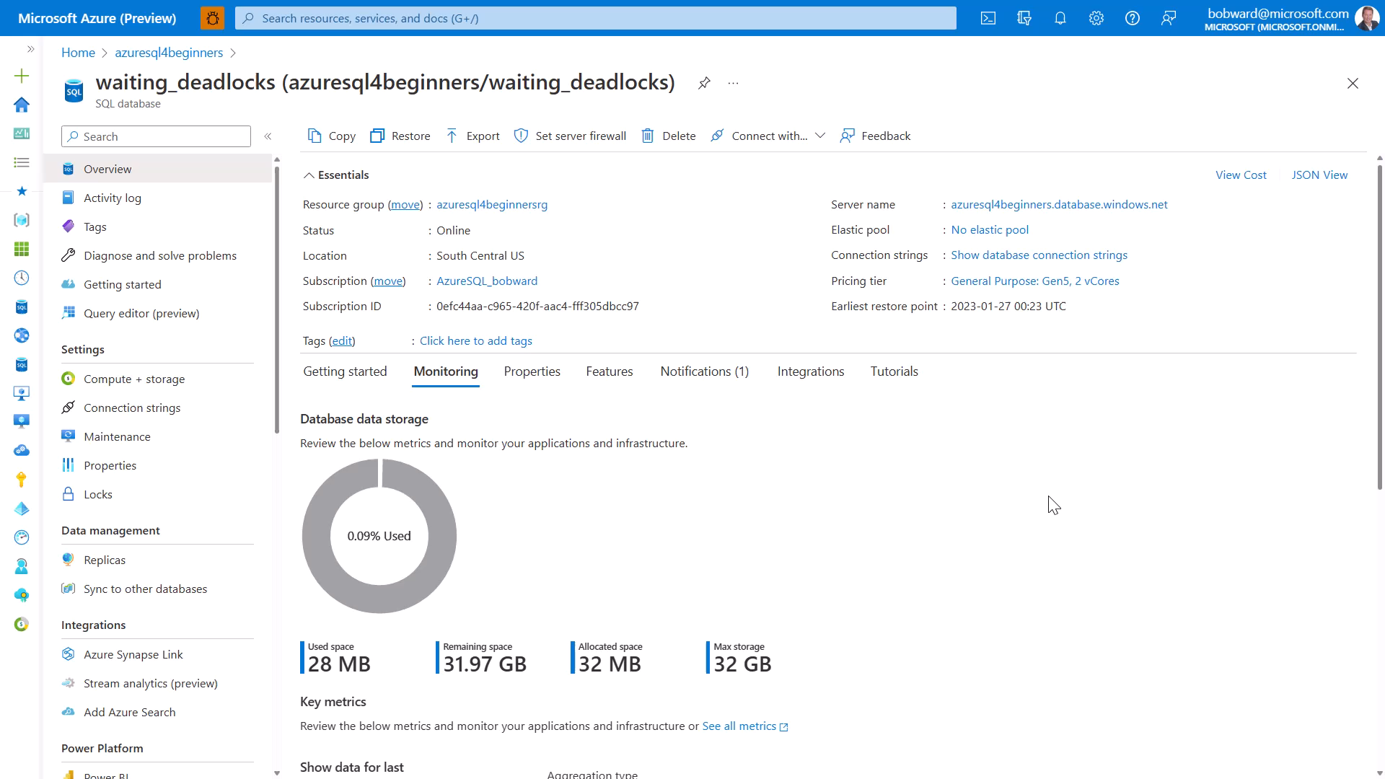
Notes:
30 secs

Slide 9
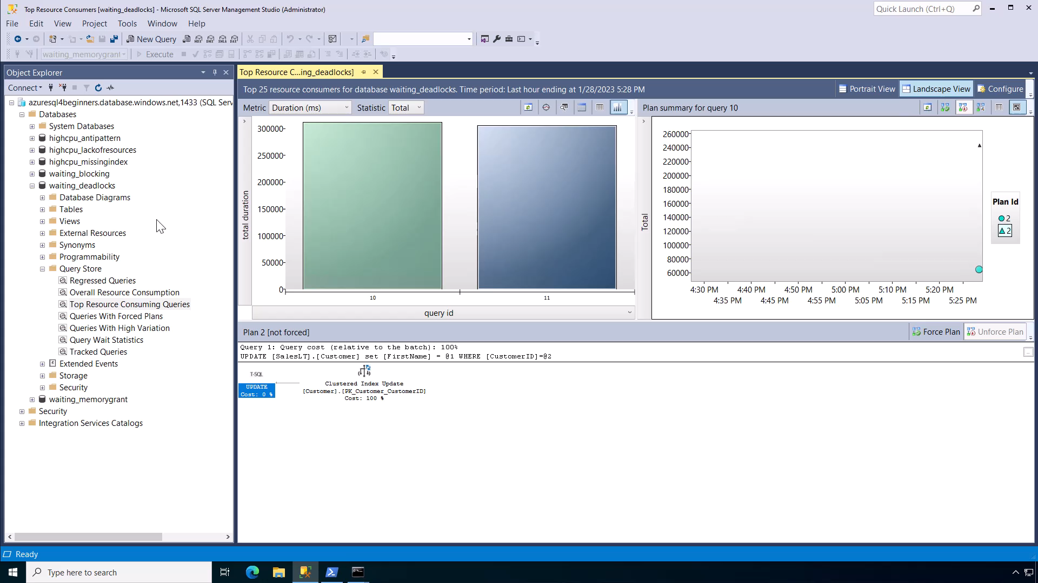
Notes:
45 secs

Slide 10
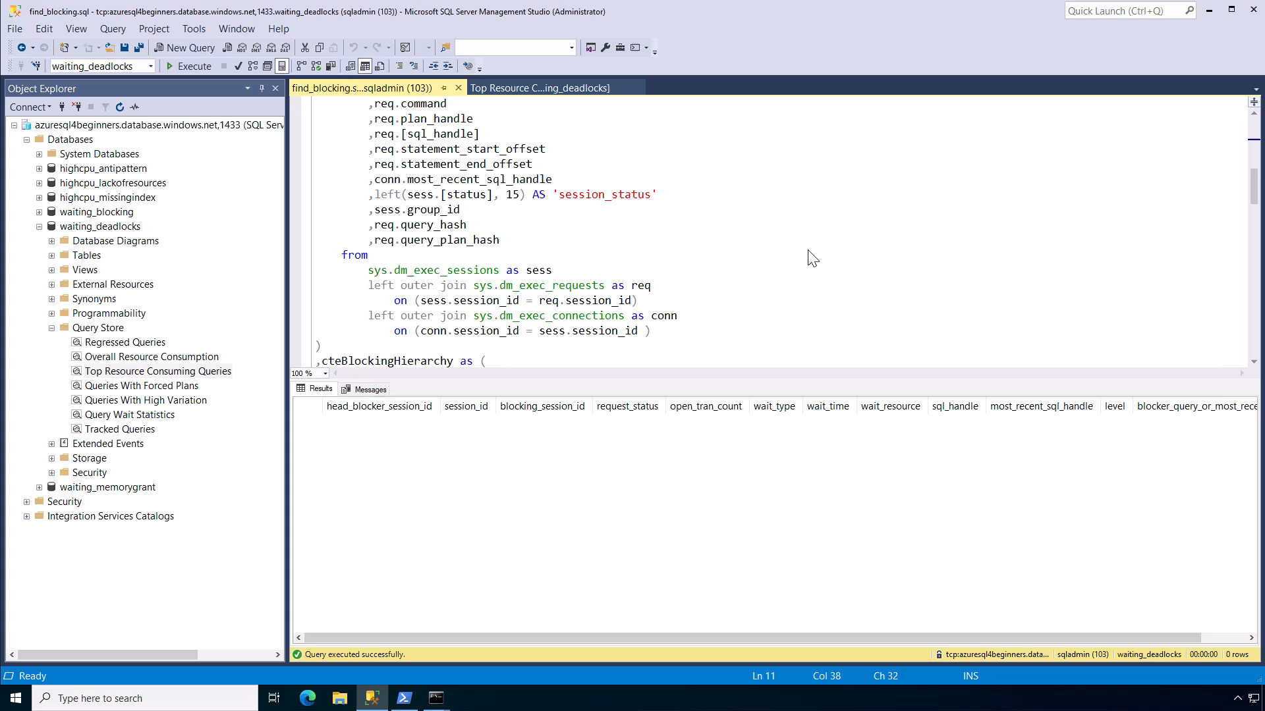
Notes:
15 secs

Slide 11

Notes:
45 secs

Slide 12

Notes:
45 secs

Slide 13
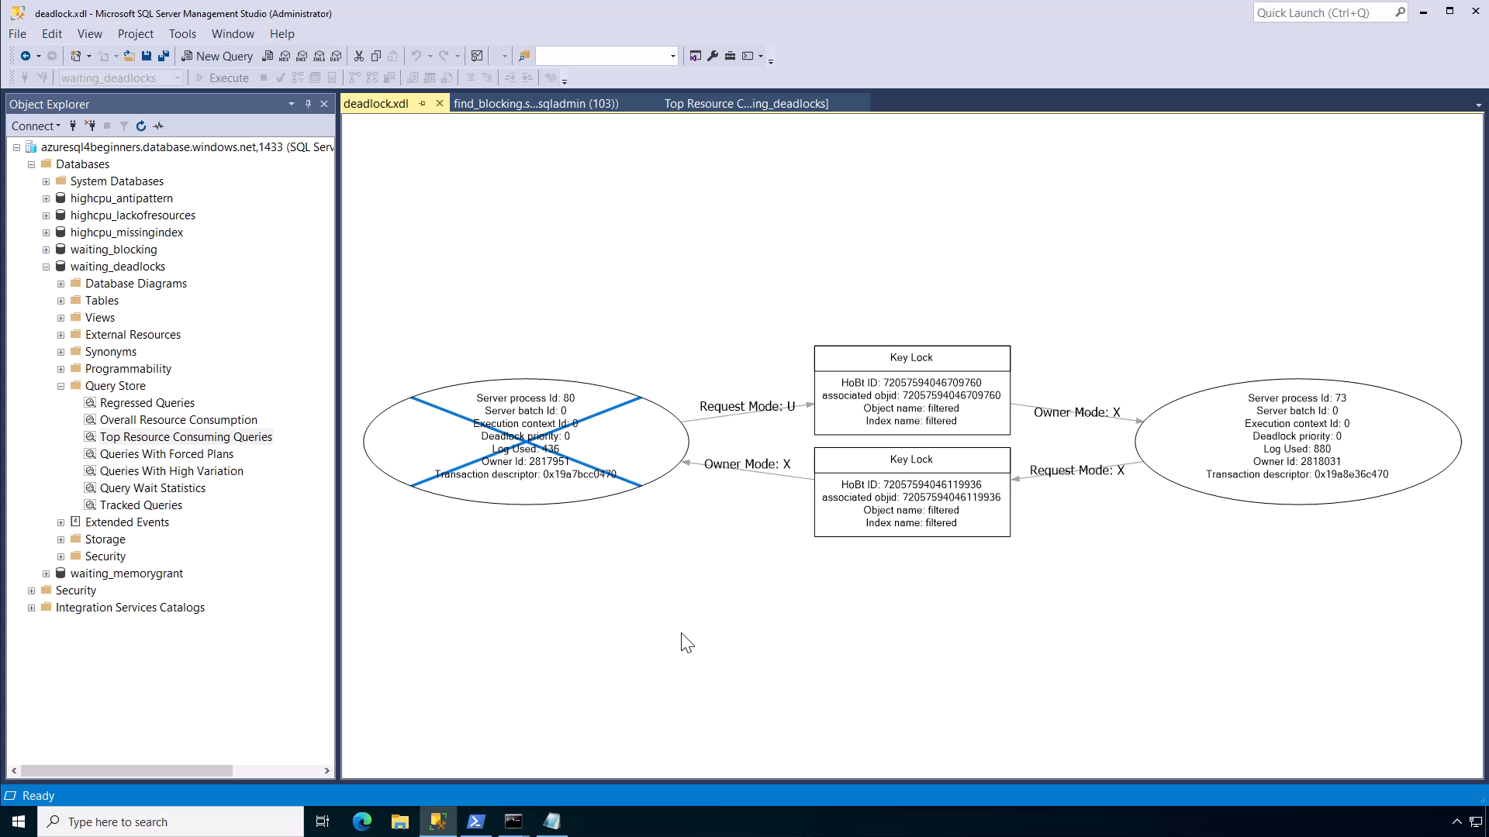
Notes:
45 secs
Demo total = 4 mins

Slide 14

Avoiding and handling deadlocks
Update tables in the same order
Keep transactions as short as possible
Tune queries and use indexes where needed
Use RCSI (default for Azure SQL Database)
Retry logic for Msg 1205 in your application

Slide 15
Summary
SQL performance problems are either running or waiting.
SQL performance problems typically involve finding out what queries are involved.
If you have low or no CPU it could be a waiting problem.
Check if blocking. If not, it could be deadlocks are occurring slowing down applications. Analyze deadlock diagnostics.
Use best practices to avoid deadlock problems in the future

Slide 16





Learn more
Learn more about SQL deadlocks
aka.ms/sqldeadlocks
Azure SQL for Beginners
aka.ms/azuresql4beginners
Azure SQL Workshop
aka.ms/azuresqlworkshop
aka.ms/azuresqlbook
Azure SQL Fundamentals
aka.ms/azuresqlfundamentals
Watch Data Exposed
aka.ms/dataexposed
See more videos from our team
aka.ms/azuresqlyt
Follow us on social media
aka.ms/azuresqltwitter
aka.ms/azuresqlfordevelopers

